Slide 1
GO Team Meeting
SCHOOL NAME
MTG DATE

Slide 2
Agenda
Call to Order
Roll Call; Establish Quorum
Action Items
Approval of Agenda
Approval of Previous Minutes:
Discussion Items
2024 Spring MAPS results
Needs Assessment
Information Items
Principal’s Report
2023-2024 Family Engagement and/or Partnership Highlights
GO Team Elections
Announcements
Public Comment (if applicable)
Adjournment

Slide 3
2024 Spring MAPS Results
Data Points to Consider
Spring Results
Fall to Spring Comparison
Literacy
Numeracy

Slide 4
MAP Reading

Slide 5
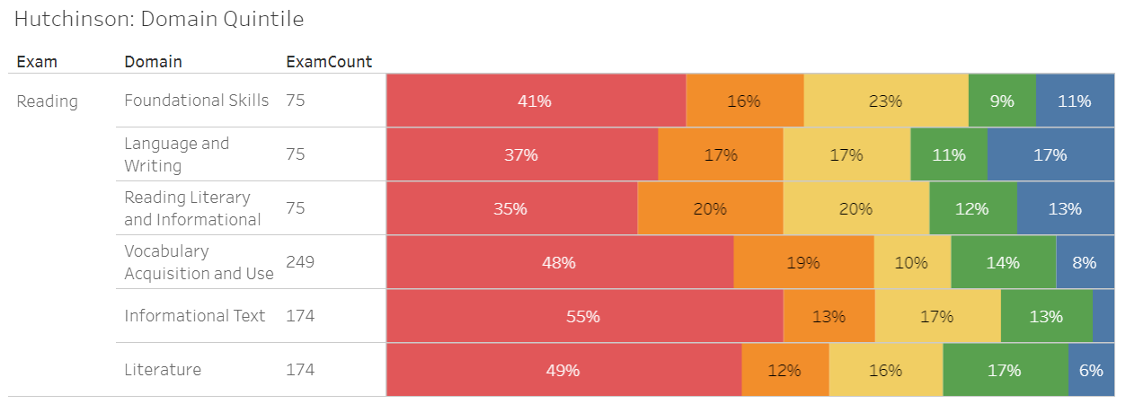
MAP Reading Domains

Slide 6
MAP Math

Slide 7
MAP Math Domains

Slide 8
Needs Assessment
Needs Assessment
During this Needs Assessment, we will look at data from the Spring MAPS administration and identify 2-3 potential needs for the 2024-2025 school year.
This discussion will help school leadership as they complete the school’s 2024-2025 Continuous Improvement Plan.
ACTIVITY

Slide 9
Needs Assessment: Guiding Questions
What does this data tell us?
What good news is there to celebrate?
Where are growth opportunities?
What trends do we see in the data?

Slide 10
Needs Assessment:
What are two to three (2-3) needs we can identify based our data?
 | Need
1 | Reading labs starting in August, small group pull outs
2 | Collaborating with Readers are Leaders instructional coach and ELA coach
3 | Including DEAR time into the instructional schedule
4 | Math pull out with instructional coach

Slide 11
Information Items

Slide 12
Principal’s Report

Slide 13
GMAS April 29th- May 14th
Field Day May 15th and 16th
PBL STEM Night May 16th 4pm- 6pm
5th Grade Transition to Long Middle May 17th
Awards Days
May 20th- Fifth and Fourth Grade
May 21st – Third Grade, PreK and Kindergarten
May 22nd – Second and First Grade
Last day for Students May 24th

Slide 14
Additional Information Items
Cluster Advisory Team Report
GO Team Elections
Find candidates at apsstrongschools.com
Vote APRIL 16-25
Households are sent a unique link based upon information in Infinite Campus
School Staff will be sent a link to their APS email address

Slide 15
Announcements
GO Team Members
Complete your end of year surveys
Principal Feedback Survey (AVAILABLE NOW! Check your email for the link)
GO Team Satisfaction Survey (Available May 1st)
Complete your required trainings ASAP
Contact the GO Team Office with any questions

